Slide 1

TAK-861 HCP Referral Analysis Insight Summary
June, 2026

Slide 2
Content
Background & Objective Analysis Foundation Methodology Executive Summary Insights Deep-dive

Slide 3
Background & Objective
Analysis Foundation
Methodology
Executive Summary
Background & Objective
The NT1 landscape
Intent
Commercial Relevance
NT1 patients navigate a long, fragmented care journey before reaching the right specialist
The path to NT1 diagnosis and treatment is long and non-linear. Patients encounter providers across primary care, psychiatry, and pulmonology well before a sleep specialist is involved. Each physician plays a distinct role in shaping whether and how quickly a patient reaches appropriate care.
Identify and prioritize HCPs who drive the journey meaningfully from those with incidental involvement
The path to NT1 diagnosis and treatment is long and non-linear. Patients encounter providers across primary care, psychiatry, and pulmonology well before a sleep specialist is involved. Each physician plays a distinct role in shaping whether and how quickly a patient reaches appropriate care.
A clear, evidence-based view of whom to engage first and how based on the role they play in the NT1 network
It can enable the commercial team to prioritize engagement driving more meaningful activation across the existing target universe. We hence focused on surface the central HCPs/HCOs/Cohorts to activate first, which referral pathways represent the greatest access opportunity, and where patients are being lost before they reach treatment.
What is the aim of this analysis?
A comprehensive understanding of how HCPs interact within the NT1 ecosystem and the distinct roles individual HCPs, HCOs, cohorts, and regions play in driving the patient journey. This structural view forms the basis for customizing activation strategies that reflect how the market actually behaves.

Slide 4
Background & Objective
Analysis Foundation
Methodology
Executive Summary
Data foundation and Business Rules
Data Sources
Analytical Boundaries
Claims Data: Komodo PLAID (Jan’16 to Jan’26) Primary source capturing patient-level medical and pharmacy claims across the full NT1 journey. Covers all HCP interactions, diagnoses, treatments, and tests for the identified patient cohort.
Only confirmed NT1/NT2 patients are included Patients must have at least two NT diagnoses recorded at least 90 days apart. This filters out incidental or erroneous coding and ensures the cohort reflects true narcolepsy cases.
Focus is on adult, commercially relevant patients Only patients aged 18 and above are included, aligning with the anticipated oveporexton labeled population and ensuring commercial applicability.
HCP Reference Data: Latest Takeda HCP profiles, IQVIA Affiliations, and Komodo NPPES Provider-level demographic and affiliation data used to enrich the HCP universe with practice location, organizational affiliations, specialty, and territory context.
Patients with consistent prior medical activity are retained Patients must show regular medical activity, irrespective of NT1 relevance, in the two years before diagnosis. This ensures data completeness and reduces the risk of incomplete claims records distorting the analysis.
Digital Engagement Data: AUXO HCP 360 HCP activity and interactions across publications, conferences, clinical trials, payments, YouTube and, Twitter/social media to capture social influence, peer engagement and, KOL reach within the NT ecosystem.
Only true care transitions count as referrals Referrals are defined as meaningful clinical handoffs like a specialty escalation, a first diagnosis, or a treatment initiation. Routine follow-ups and repeat encounters are excluded to avoid inflating referral volumes with noise.
Observation window
First NT Dx window: 2022–2025
6-year pre-diagnosis lookback from each patient's first NT diagnosis, plus complete post-diagnosis journey till Jan’26, ensuring the full care pathway is captured within Komodo.
Provider relationships are validated before entering the network A referral link between two HCPs is only included if they share more than one patient or if a clinically meaningful first event is recorded. This keeps the network grounded in sustained, intentional referral behavior.

Slide 5
Background & Objective
Analysis Foundation
Methodology
Executive Summary
Analytical methodology
Define the patient and HCP universe Using the analytical boundaries, a validated cohort of confirmed NT1/NT2 patients and all the healthcare providers who interacted with them across the care journey was identified. This forms the analytical foundation for everything that follows.
1
Capture all clinically relevant interactions Every meaningful and clinically significant HCP interaction across the patient journey, including NT1 diagnosis events, treatment initiation and changes, relevant diagnostic tests, and prior misdiagnosis or management of related conditions such as sleep apnea, anxiety, and mood disorders were captured.
2
Build the referral network HCPs were connected based on shared patient interactions to construct a referral network. It showed who is referring to whom, for what type of clinical event, and across how many patients. Connections with limited or incidental patient overlap were excluded, keeping the network focused on sustained, meaningful referral relationships.
3
Identify and rank the most important HCPs Leveraging appropriate Data Science algorithms, each HCP in the network was scored to surface the nuanced functional role they play in the ecosystem. For e.g., whether they see the most NT patients, send the most referrals, sit at the center of the network connecting others, or carry outsized influence over patient routing decisions.
4
Understand how the ecosystem behaves Beyond individual HCPs, appropriate DS algorithms were applied to also surface how groups of closely connected providers behave together, where patients are being lost or delayed before reaching the right care, and which HCPs carry the broadest influence across the ecosystem through their professional and social engagement. Together these lenses reveal the structural dynamics that shape patient access to NT1 care.
5

Slide 6
Background & Objective
Analysis Foundation
Methodology
Executive Summary
Executive Summary
717 + 315
Super Diagnosers & Treaters
3.1k Super Perons HCPs Cover 53% of decile 5–10 targets
Super Diagnosers and Treaters Manage NT volumes 16x / 7x above average; 73–75% Innovators. 280 Bridgers link the broader HCP network
Primary conversion targets at launch Focus engagement on mechanism differentiation, clinical benefits, and appropriate patient identification for oveporexton
280 + 1,271 + 549 Bridgers, Key Influencers, Super Referrers
Bridgers connect the broader HCP universe to clinical anchors, ensuring patients reach appropriate care.
Key Influencers are the most cross-connected HCPs in the network (Top 90th percentile) while Super Referrers (53% PCP) consistently forward patients toward the NT1 care
Scale referral flow and sustain patient momentum
Engage Bridgers to expand referral reach beyond anchor accounts into community HCPs
Activate Key Influencers closer to launch to accelerate network-wide adoption through peer influence
Maintain Super Referrer engagement post-launch to sustain consistent patient flow
278
Untapped High-Influence HCPs
Outside Takeda’s engagement but have disproportionately high professional influence through their digital social network activity
Activate for scientific outreach and indirect network influence pre-launch
Engage ahead of launch for oveporexton scientific communication.
~70%
Misdiagnosis Rate
Delays of 344–361 days across top pathways with leakage patterns varying by specialty. 5,023 sink nodes stall patient flow
Reduce patient loss before diagnosis through targeted re-engagement
Identify and activate sink nodes with referral enablement and NT symptom education to convert passive nodes into active referrers with distinct engagement strategies by specialty
548
Self-sustained Hubs
548 hubs independently manage the full diagnosis-to-treatment pathway
Quick-switch pre-launch activation cohort
Converting a single hub HCP propagates through the entire cluster, maximizing reach per engagement and accelerating patient volume at launch
Interactive Dashboard: https://us-east-1.online.tableau.com/t/usbutakeda/views/NT1ReferralNetworkDashboard/HCPNetwork

Slide 7
Content
Background & Objective Analysis Foundation Methodology Executive Summary Insights Deep-dive

Slide 8
Patient – HCP Referral Identification

Slide 9
Sequential business rules are applied to maximize diagnostic validity, longitudinal stability, and commercial relevance of the NT1/NT2 cohort
Business Rules¹
Rationale / Considerations
# Patients (% of Prior)
Using ICD Codes: G47.411, G47.421, G47.419, G47.429
Patients with at least 1 NT1/NT2 Diagnosis within 2022-2025
342.8K
Patients with min. two NT1/NT2 Diagnosis at least 90 days apart
Increases confidence in true NT1/NT2 patients' identification and helps exclude misdiagnosed cases
184.2K (54%)
Patients aged 18 years and above
(Calculated as year of 1st NT1/NT2 diagnosis within 2022-2025 minus the birth year of the patient )
Aligns with conservative labeled population (18+ years) and ensures commercial relevance²
177.5K (96%)
Incident patients are selected to analyze pre-diagnosis referral patterns and patient flow across HCPs leading up to first NT1/NT2 diagnosis
61.6K (35%)
Incident Patients within 2022-2025
(i.e., Patients with their 1st NT1/NT2 Dx on or after 2022)
Base cohort for all the following analysis
Patients with stable lookback period
(i.e., patients having medical activity in each semester during the two years prior to their first diagnosis date)
Stability criteria act as a proxy for closed claims, ensuring consistent longitudinal data capture and improving confidence in patient visibility within the Komodo dataset
46.8K (76%)
Data Source: KOMODO PLAID data from Jan’15 to Jan’26
Takeda’s expected label for TAK-861 is 16+ years but aligned on 18+ age bucket for this analysis given uncertainty and issues with promotion to paediatrician

Slide 10
Claims-based HCP universe for ~46.8K patients shows ~97% overlap with Top Decile (D10–6) HCPs, indicating strong alignment with the current target list
Decile/Specialty | Neurology | Pysch | Pulmonary | General Care | Others | Total
10 | 100% | 100% | 100% | 100% | - | 76|100%
9 | 100% | 100% | 100% | 99% | 100% | 177|99%
8 | 99% | 100% | 100% | 98% | - | 310|99%
7 | 99% | 100% | 99% | 98% | 100% | 474|99%
6 | 95% | 83% | 97% | 94% | 100% | 705|95%
5 | 94% | 91% | 95% | 94% | 100% | 1,150|94%
4 | 84% | 77% | 92% | 87% | 77% | 2,142|88%
3 | 75% | 69% | 82% | 64% | 73% | 4,698|70%
2 | 65% | 80% | 71% | 73% | 50% | 728|68%
1 | 58% | 57% | 67% | 52% | 52% | 489|59%
Total | 79% | 72% | 86% | 73% | 68% | 10,949|78%
n = 299,026
(Claims Universe)
288,077
10,949(78%)
3,137 (22%)
n = 14,086
(Takeda Target List)
190,797
62,427 (29%)
Claims universe has been created by considering relevant claims¹ For identified 46.8K patient universe from 6yrs pre and complete post-diagnosis journey
Note: % corresponds to the overlap with Takeda’s existing target list
1. Considers activities like NT1 Diagnosis, Relevant Misdiagnosis, Relevant NT1 Test, Relevant NT1 Treatment

Slide 11
Recognizing the complexity of NT1 patient journeys, we developed and aligned on a referral grid to systematically capture care transitions
Different type of referral activity
Specialty Change Scenario | Same Misdiagnosis | Separate Misdiagnosis | First Test | Repeated Test | First NT Diagnosis | Repeated NT Diagnosis | Treatment Initiation (any 1st Relevant Drug) | Same treatment | Treatment Change
Tier Upgrade Example: Tier 2 → Tier 1
Tier Downgrade Example: Tier 1 → Tier 2
Same Tier Same Spec Example: Tier 2 Neuro → Tier 2 Neuro
Same Tier Different Spec Example: Tier 2 Neuro → Tier 2 Psych
Business Rationale: Referrals represent true transfer of care or escalation, not routine follow‑up or shared management (Logic is applied conservatively to ensure the referral network reflects real‑world patient hand‑offs and physician decision‑making, not claims noise)
Specialty tier upgrades (e.g., PCP → Neuro/Sleep) are classified as referrals as they reflect escalation in clinical responsibility
Introduction of new clinical value—first NT diagnosis, treatment initiation or change, or first diagnostic test—is treated as a referral, even within the same specialty tier
Repeated or ongoing activities (same diagnosis, same test, same treatment) are excluded to avoid inflating referral volumes
Syntax
Referral
Not a referral
Aligned Specialty Tiering:
Tier 1: Sleep Specialist; Tier 2: Neuro, Psych, Pulmo; Tier 3: Other Specialists;;Tier 4: PCP, NP, PA; Tier 5: Other non-Specialists

Slide 12
Diagnosis Journey

Slide 13
NT1 diagnosis is anchored in PCP-led pathways, while post-diagnosis care disperses across specialist networks driven by referrals
With Referral
No Referral
Specialty Distribution at NT Diagnosis
Top Pathways¹ | % Patients
PCP→ | 23%
Neuro/Psych→ | 7%
PCP → Neuro/Psych→ | 6%
Other→ | 6%
PCP→ | 20%
PCP → Sleep Specialist→ | 16%
Neuro/Psych→ | 12%
Neuro/Psych → Sleep Specialist→ | 7%
Neuro/Psych→ | 20%
PCP→ | 20%
PCP→ | 19%
PCP → Pulmonologist→ | 16%
PCP→ | 22%
Neuro/Psych→ | 9%
Pre-diagnosis
PCP
Post-diagnosis
Top Pathways | % Patients
→PCP → Neuro/Psych | 14%
→PCP | 10%
→PCP → Other | 9%
→PCP → Sleep Specialist | 9%
→PCP → Sleep Specialist | 20%
→Neuro/Psych → Sleep Specialist | 12%
→Other → Sleep Specialist | 9%
→NPPA → Sleep Specialist | 7%
→PCP → Neuro/Psych | 17%
→Neuro/Psych | 15%
→PCP → Pulmonologist | 16%
→Pulmonologist → Neuro/Psych | 9%
→NPPA→ Neuro/Psych | 8%
→NPPA→PCP | 8%
These HCPs are involved in some relevant referral activity in the pre-diagnosis period (for relevant tests, misdiagnosis journey or pre-diagnosis treatment journey)
Sleep Specialist
Neuro/Psych
Pulmonologist
Other
NPPA
n=32K Patients
1. Last HCP of the pathway may or may not be same as the diagnosing HCP

Slide 14
PCPs act as the central coordinators in the pre-diagnosis journey, directing patients across specialties through referral pathways
With Referral
No Referral
Spec Distribution at NT Diagnosis
Top Pathways1 | %Patients
PCP→ | 23%
Neuro/Psych→ | 7%
PCP → Neuro/Psych→ | 6%
Other→ | 6%
PCP→ | 20%
PCP → Sleep Specialist→ | 16%
Neuro/Psych→ | 12%
Neuro/Psych → Sleep Specialist→ | 7%
Neuro/Psych→ | 20%
PCP→ | 20%
PCP→ | 19%
PCP → Pulmonologist→ | 16%
PCP→ | 22%
Neuro/Psych→ | 9%
Pre-diagnosis
PCP
Post-diagnosis
Top Pathways | %Patients
→PCP → Neuro/Psych | 14%
→PCP | 10%
→PCP → Other | 9%
→PCP → Sleep Specialist | 9%
→PCP → Sleep Specialist | 20%
→Neuro/Psych → Sleep Specialist | 12%
→Other → Sleep Specialist | 9%
→NPPA → Sleep Specialist | 7%
→PCP → Neuro/Psych | 17%
→Neuro/Psych | 15%
→PCP → Pulmonologist | 16%
→Pulmonologist → Neuro/Psych | 9%
→NPPA→ Neuro/Psych | 8%
→NPPA→PCP | 8%
Key Insights
PCPs are the primary entry point - ~37% of patients have their first NT1 diagnosis claim associated with a PCP, making them the most common initial touchpoint.
Sleep specialists are the second key diagnosing specialty - Referrals most commonly flow from PCP → Sleep Specialist, highlighting this as the dominant pathway to diagnosis.
Referrals play a critical role pre-diagnosis - ~80% of patients had at least one referral before receiving an NT1 diagnosis.
PCPs anchor the referral journey - Among patients with referrals, PCPs are the most consistent and central coordinators, appearing frequently across referral pathways.
Sleep Specialist
Neuro/Psych
Pulmonologist
Other
NPPA
n=32K Patients
1. Last HCP of the pathway may or may not be same as the diagnosing HCP

Slide 15
Post-diagnosis management shifts to specialists, with referral pathways enabling continued care beyond the diagnosing HCP
With Referral
No Referral
Spec Distribution at NT Diagnosis
Top Pathways1 | %Patients
PCP→ | 23%
Neuro/Psych→ | 7%
PCP → Neuro/Psych→ | 6%
Other→ | 6%
PCP→ | 20%
PCP → Sleep Specialist→ | 16%
Neuro/Psych→ | 12%
Neuro/Psych → Sleep Specialist→ | 7%
Neuro/Psych→ | 20%
PCP→ | 20%
PCP→ | 19%
PCP → Pulmonologist→ | 16%
PCP→ | 22%
Neuro/Psych→ | 9%
Pre-diagnosis
PCP
Post-diagnosis
Top Pathways | %Patients
→PCP → Neuro/Psych | 14%
→PCP | 10%
→PCP → Other | 9%
→PCP → Sleep Specialist | 9%
→PCP → Sleep Specialist | 20%
→Neuro/Psych → Sleep Specialist | 12%
→Other → Sleep Specialist | 9%
→NPPA → Sleep Specialist | 7%
→PCP → Neuro/Psych | 17%
→Neuro/Psych | 15%
→PCP → Pulmonologist | 16%
→Pulmonologist → Neuro/Psych | 9%
→NPPA→ Neuro/Psych | 8%
→NPPA→PCP | 8%
Key Insights
Post-diagnosis care is largely referral-driven - ~60% of patients transition to NT1-relevant specialists (e.g., Sleep Specialists) for ongoing management, treatment, and testing.
Sleep specialists are the primary destination post-diagnosis - The most common pathways involve referrals into Sleep Specialists from PCPs and other specialties.
~40% of patients do not have a recorded referral post-diagnosis. This group includes a mix of care patterns:
~30% continue care across multiple HCPs without a formal referral (e.g., second opinions or direct visits)
~5% remain with the diagnosing HCP for ongoing management
~5% are recently diagnosed with limited follow-up visibility
Sleep Specialist
Neuro/Psych
Pulmonologist
Other
NPPA
n=32K Patients
1. Last HCP of the pathway may or may not be same as the diagnosing HCP

Slide 16
Referral Network Analysis

Slide 17
Executive Summary | Referral Network Overview
Insights
Preliminary Recommendations
Of the 299k HCPs interacting with NT patients, 67k are active in referrals and a core 3.1k hold an established, recurring role within the referral network, accounting for 53% of decile 5-10 target coverage.
This group is primary led by Sleep Specialists (28%), PCPs (21%), and Pulmonologists (19%).
The 3.1k core is geographically concentrated in Ohio, Michigan, and Texas, with sparser representation across central and southern markets.
Super Diagnosers and Super Treaters should be the primary conversion targets at launch given their high NT patient volumes and central role within the referral network.
Early engagement should focus on mechanism differentiation, clinical benefits, and identifying appropriate patients for oveporexton treatment.
Bridgers can play an important role in expanding referral flow across the broader NT1 ecosystem by connecting community HCPs to key diagnosing and treating centers.
Targeted education around referral pathways, patient identification, and care coordination can help scale adoption beyond the initial anchor accounts.
Key Influencers should be activated closer to launch to drive peer-to-peer awareness and broader network adoption.
Given their strong cross-network connectivity, early conversion within this group can accelerate confidence and uptake across a wider HCP base without requiring broad-based outreach.
Super Referrers should remain consistently engaged post-launch to sustain referral momentum into the NT1 treatment pathway.
Reinforcing referral triggers, treatment awareness, and center connectivity can help maintain long-term patient flow into the ecosystem.
Network Structure
Super Diagnosers (n=717) and Super Treaters (n=315) are the clinical anchors of the network, concentrated in Sleep Medicine and Pulmonology/Neurology, managing NT patient volumes 16x and 7x the market average respectively. Both skew strongly toward the Innovator attitudinal segment (73–75%)
A key group of HCPs act as Bridgers (n=280) directing patients from the broader HCP universe to these clinical anchors, ensuring patients receive appropriate care immediately post referral.
Key Influencers (n=1,271) are the most cross-connected HCPs, managing ~9 NT patients per HCP (Top 90th Percentile) and connecting various parts of the referral network.
549 Super Referrers consistently forward patients toward the NT1 care pathway and are PCP-dominant (53%).
HCP Roles Within the Network
Interactive Dashboard: https://us-east-1.online.tableau.com/t/usbutakeda/views/NT1ReferralNetworkDashboard/HCPNetwork

Slide 18
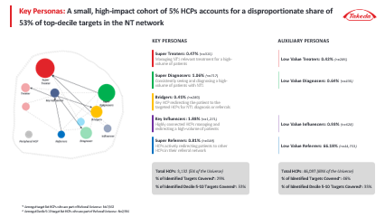
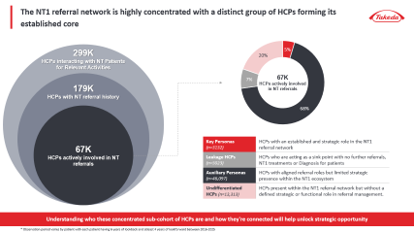
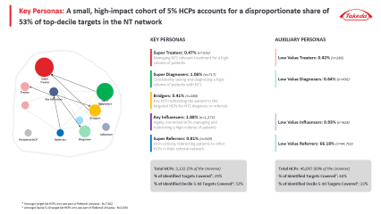
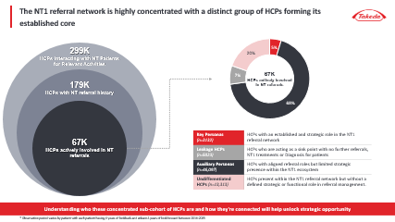
As a first step, the tagged referral data was transformed into a weighted network graph and analyzed using network intelligence algorithms to identify key HCP personas
Referral Network Overview
Key Analysis
HCP Referral Relationships: Identify the way HCPs within the universe interact with each other through patient hand-offs to ascertain what qualifies as referrals vs what might be disjointed interactions.
NT1 Referral Network Graph: Establish the provider-patient-provider transitions through their the NT1 journey and surface the established referral routes within the market.
HCP Personas: Isolate and tag the HCPs who play an influential and distinct role in the NT1 patients’ referral journey persistently.
Notes:
Here we are bringing together the full value of the engagement how we translate claims and referral data into a practical understanding of the narcolepsy ecosystem that Takeda can act on for launch.
We start with referral network structure, because in narcolepsy the way patients move is rarely linear. Instead of viewing care as a sequence of visits, we reconstruct the ecosystem as a network of providers and institutions connected by real patient flows.
This makes visible the structure that governs
where patients go,
who sits upstream,
who receives referrals,
and how tightly or loosely connected different parts of the system are.
This structural view becomes the foundation for everything else on the slide.
From there, we identify key referral hubs and bridge HCPs.
These are the providers and institutions that disproportionately influence patient movement either by anchoring referral pathways or by connecting specialties, care settings, or systems that would otherwise remain siloed.
Importantly, these control points don’t always align with the highest‑volume prescribers.
For launch, this helps Takeda focus attention on the HCPs and HCOs that shape access and downstream treatment behavior, not just those who see the most patients today.
The next layer translates the national network into regional distribution and clusters.
Referral behavior varies significantly by geography, driven by local systems, access constraints, and practice patterns.
By segmenting the ecosystem into regional clusters, we can characterize where networks are dense and coordinated versus fragmented and dependent on a small number of connectors.
This allows Takeda to move from a single national view to region‑specific insights that align with how the field actually operates.
Building on that, we identify regional opportunity areas.
These are geographies where fragmentation, under‑connected networks, or reliance on a limited set of hubs create opportunities for targeted education and engagement.
Rather than treating all regions equally, this output helps prioritize where focused intervention is most likely to accelerate diagnosis and treatment initiation ahead of launch.
We then shift from structure to patient flow and leakage.
This output identifies where patients stall, divert, or drop out across the care journey from suspicion to diagnosis to treatment.
Instead of viewing leakage as a generic problem, we quantify where it occurs and how frequently, providing a clear view of the specific points in the journey that delay care.
Crucially, we connect those leakage points back to the ecosystem through root‑cause analysis.
This helps distinguish whether delays are driven by missing referral bridges, access limitations, specialty handoffs, or network fragmentation.
For Takeda, this reframes leakage from a broad awareness challenge into a set of targeted, addressable issues tied to specific providers, regions, or structures.
Finally, we assess peer influence and adoption dynamics.
Adoption in specialty ecosystems rarely happens in isolation it propagates through professional relationships and referral networks.
By quantifying influence and connectivity, we identify where adoption is likely to spread quickly and where it may be slower due to network constraints.
This helps Takeda anticipate diffusion dynamics ahead of launch and prioritize stakeholders who can accelerate uptake beyond their own prescribing behavior.
Taken together, these outputs provide a unified ecosystem view showing who controls patient movement, how that varies by region, where patients leak, and how influence shapes adoption.
The goal is not just insight, but clear, actionable guidance that informs commercial, medical, and field execution as Takeda prepares for launch.

Slide 19
The NT1 referral network is highly concentrated with a distinct group of HCPs forming its established core
299K HCPs interacting with NT Patients for Relevant Activities
67K HCPs actively involved in NT referrals
179K HCPs with NT referral history
Key Personas (n=3132) | HCPs with an established and strategic role in the NT1 referral network
Leakage HCPs (n=5023) | HCPs who are acting as a sink point with no further referrals, NT1 treatments or Diagnosis for patients
Auxiliary Personas (n=46,097) | HCPs with aligned referral roles but limited strategic presence within the NT1 ecosystem
Undifferentiated HCPs (n=13,313) | HCPs present within the NT1 referral network but without a defined strategic or functional role in referral management.
67K HCPs actively involved in NT referrals
Understanding who these concentrated sub-cohort of HCPs are and how they're connected will help unlock strategic opportunity
* Observation period varies by patient with each patient having 6 years of lookback and atleast 4 years of lookforward between 2016-2025

Slide 20
These HCP personas capture the distinct roles patients encounter as they navigate the NT1 referral network from initial symptoms to eventual treatment
Super Referrers
Key Influencers
Bridgers
Super Diagnosers
Super Treaters
HCPs actively redirecting patients to other HCPs in their referral network
Highly connected HCPs managing and redirecting a high-volume of patients
Key HCP redirecting the patient to the targeted HCPs for NT1 diagnosis or referrals
Consistently seeing and diagnosing a high-volume of patients with NT1
Managing NT1 relevant treatment for a high-volume of patients
Key Personas
Referral Strength: Weighted outdegree > 90th Percentile and Weighted indegree < 10th Percentile
Patient Volume: Interacted patient volume ≥ ~90th Percentile
Referral Activity: Referral activity with 2+ patients
Network Influence: Top 10% PageRank
OR
Connection Strength: Unique # of Connected HCPs > median
Patient Volume: Interacted patient volume ≥ ~90th Percentile
Network Influence: Top ~15% betweenness subset centrality
Rerouting Intensity: Min. 2 patients referred out
OR
Rerouting Value: 25%+ patients received NT Dx/Tx immediately post referral (min n=3)
Connection Strength: Inbound Referral Connections with ≥ 2 unique HCPs
Network Influence: Top 10% weighted indegree
Diagnosing Intensity: First NT diagnosing volume ≥ 95th percentile
Patient Volume: Interacted patient volume ≥ 90th Percentile
Network Influence: Top 10% weighted indegree
Treatment Intensity: NT-treated patient volume > 95th percentile
Patient Volume: Interacted patient volume ≥ 90th Percentile
Low Value Referrers: Referred out at least 1 patient
Low Value Influencers: Referral activity with at least 4 patients
Low Value Diagnosers: First NT diagnosing volume ≥ 90th percentile
Low Value Treaters: NT-treated patient volume > 90th percentile
Auxiliary Personas
A single HCP can have multiple personas; However, for a 1:1 tagging we have used the one they most often showcase
All interacted patient volumes are based on the identified NT patient cohort throughout their journey, including pre-diagnosis
All insights shown here are interim and subject to change post validation across all the dependent KBQs currently under analysis
Notes:
Total HCPs : 67,197 Targeted Cohort: 5,207 Treaters: 265 Diagnosers: 296 Bridgers: 96 Influencers: 621 Referrers: 3929

Slide 21
A small, high-impact cohort of 5% HCPs accounts for a disproportionate share of 62% of top-decile targets in the NT network
Super Treaters: 0.47% (n=315)
Treaters: 0.43% (n=286)
Super Treater
Super Diagnosers: 1.07% (n=717)
Diagnosers: 0.64%
(n=430)
Treater
Bridgers: 0.42%
(n=280)
Key Influencer
Super Diagnosers
Key Influencers: 1.9%
(n=1271)
Influencers: 0.93%
(n=628)
Bridgers
Super Referrers: 0.82%
(n=549)
Referrers: 67%
(n=44,753)
Influencer
Peripheral HCP
Referrers
Diagnoser
Total HCPs: 3,132 (5% of the Universe)
% of Identified Targets Covered*: 29%
% of Identified Decile 6-10 Targets Covered^: 62%
Total HCPs: 46,097 (69% of the Universe)
% of Identified Targets Covered*: 46%
% of Identified Decile 6-10 Targets Covered^: 28%
* Amongst target list HCPs who are part of Referral Universe : N=7562

Slide 22
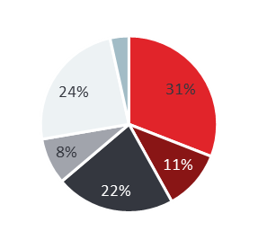
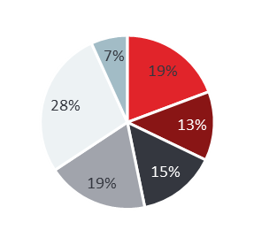
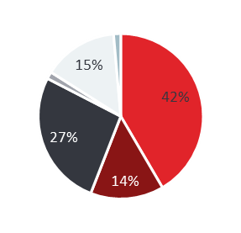
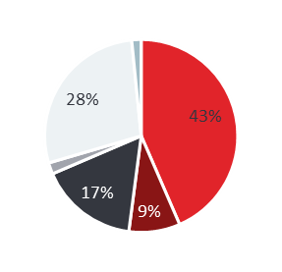

While Super Diagnosers and Key Influencers drive the highest share of top-decile targets, they require fundamentally different engagement strategies due to distinct specialty and profile mix
Super Referrers
Key Influencers
Bridgers
Super Diagnosers
Super Treaters
(n=549)
(n=1271)
(n=280)
(n=717)
(n=315)
Specialty Mix
% of Target List Covered*
2% | 12% | 2% | 9% | 4%
2% | 18% | 3% | 25% | 14%
Holistic Treaters (53%) | Innovators (50%) | Holistic Treaters (40%) | Innovators (45%) | Holistic Treaters (42%) | Innovators (73%) | Innovators (75%)
~3 pts/HCP receiving referrals vs market avg. <2 | ~9 pts/HCP managed vs market avg. ~2 | ~12 pts/HCP managed vs market avg. ~2 | ~16 pts/HCP receiving NT diagnosis vs market avg. ~1 | ~7 pts/HCP receiving NT treatments vs market avg. <1
% of Decile 6-10 Covered*
Primary Attitudinal Segment
Key patient referral insights
* Amongst target list HCPs who are part of Referral Universe : N=7585
Notes:
Total HCPs : 67,197 Targeted Cohort: 5,207 Treaters: 265 Diagnosers: 296 Bridgers: 96 Influencers: 621 Referrers: 3929

Slide 23
Deep Dive Insights

Slide 24
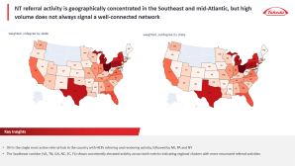

Leveraging the referral network, we deep-dive into insights across geography, patient flow, and influence dynamics
Regional Care Patterns
Patient Leakage Assessment
Influence Network Mapping
Key Analysis
Ecosystem Segmentation: Clustered self sustained regional referral ecosystems to reveal communities of strong referral relationships
Regional Profiling: Aggregated network metrics at regional level to understand the differences in care patterns
Patient Journey Leakage: Identified where patients stall, divert, or temporarily exit the referral pathway before correct diagnosis or treatment
HCP Barrier Profiling: Characterized systemic patterns of patient leakage to uncover the HCPs, and geographies requiring focused intervention
Diffusion Readiness Assessment: Evaluated how adoption propagates across referral relationships and connected networks
Influence Landscape Mapping: Identified providers with most prominent social and research influence amongst their peers and identified the Key leaders of social influence
KOL Overlap Assessment: Assessed how many KOLs overlap with the identified key persona HCPs and why the rest of the KOLs are not tagged as such
Notes:
Here we are bringing together the full value of the engagement how we translate claims and referral data into a practical understanding of the narcolepsy ecosystem that Takeda can act on for launch.
We start with referral network structure, because in narcolepsy the way patients move is rarely linear. Instead of viewing care as a sequence of visits, we reconstruct the ecosystem as a network of providers and institutions connected by real patient flows.
This makes visible the structure that governs
where patients go,
who sits upstream,
who receives referrals,
and how tightly or loosely connected different parts of the system are.
This structural view becomes the foundation for everything else on the slide.
From there, we identify key referral hubs and bridge HCPs.
These are the providers and institutions that disproportionately influence patient movement either by anchoring referral pathways or by connecting specialties, care settings, or systems that would otherwise remain siloed.
Importantly, these control points don’t always align with the highest‑volume prescribers.
For launch, this helps Takeda focus attention on the HCPs and HCOs that shape access and downstream treatment behavior, not just those who see the most patients today.
The next layer translates the national network into regional distribution and clusters.
Referral behavior varies significantly by geography, driven by local systems, access constraints, and practice patterns.
By segmenting the ecosystem into regional clusters, we can characterize where networks are dense and coordinated versus fragmented and dependent on a small number of connectors.
This allows Takeda to move from a single national view to region‑specific insights that align with how the field actually operates.
Building on that, we identify regional opportunity areas.
These are geographies where fragmentation, under‑connected networks, or reliance on a limited set of hubs create opportunities for targeted education and engagement.
Rather than treating all regions equally, this output helps prioritize where focused intervention is most likely to accelerate diagnosis and treatment initiation ahead of launch.
We then shift from structure to patient flow and leakage.
This output identifies where patients stall, divert, or drop out across the care journey from suspicion to diagnosis to treatment.
Instead of viewing leakage as a generic problem, we quantify where it occurs and how frequently, providing a clear view of the specific points in the journey that delay care.
Crucially, we connect those leakage points back to the ecosystem through root‑cause analysis.
This helps distinguish whether delays are driven by missing referral bridges, access limitations, specialty handoffs, or network fragmentation.
For Takeda, this reframes leakage from a broad awareness challenge into a set of targeted, addressable issues tied to specific providers, regions, or structures.
Finally, we assess peer influence and adoption dynamics.
Adoption in specialty ecosystems rarely happens in isolation it propagates through professional relationships and referral networks.
By quantifying influence and connectivity, we identify where adoption is likely to spread quickly and where it may be slower due to network constraints.
This helps Takeda anticipate diffusion dynamics ahead of launch and prioritize stakeholders who can accelerate uptake beyond their own prescribing behavior.
Taken together, these outputs provide a unified ecosystem view showing who controls patient movement, how that varies by region, where patients leak, and how influence shapes adoption.
The goal is not just insight, but clear, actionable guidance that informs commercial, medical, and field execution as Takeda prepares for launch.

Slide 25
Executive Summary | Influence Network Mapping
Insights
Preliminary Recommendations
No meaningful adoption propagation is observed within connected communities. Between immediately connected HCPs, modest signals emerge at 180 days (17.7%), growing to 36% at 365 days. Showing that adoption influence might be exerted only to the immediate HCP and does not propagate extensively.
For co-located HCPs, the signal at 180 days slightly improves (~29%). However, it is indicative of institutional access drivers instead.
Given the limited branded therapy data capture in the underlying dataset, these findings reflect a data constraint rather than an absence of influence. This analysis warrants re-exploration once branded treatment data is available.
Re-run the adoption propagation analysis with branded SP claims data post-launch to establish peer influence coefficients at the HCP pair level. This will enable influence-adjusted targeting and identify which connected HCPs are most likely to switch the treatment choice following a network peer.
Treatment Adoption Propagation
Beyond claims-based referral relationships, the Digital Influence Network identifies 3,745 HCPs connected through publications, clinical trials, conferences, payments, and media.
Of these, 278 carry high influence scores based on composite PageRank and Betweenness Centrality and are currently outside Takeda's engagement universe, collectively accounting for 14% of total social network activity with approximately 25 activity events per HCP.
While the 278 digital network-identified high-influence HCPs are not part of referral network, they can help support scientific engagement ahead of launch. Their disproportionate share of social activity makes them effective channels for oveporexton scientific communication beyond the referral network.
Digital Influence Network
KOL Overlap
73% of the 60 KOLs in the NT space map directly to a Super Persona in the referral network, with Super Diagnosers (40%) and Super Treaters (18%) dominating. The remaining 27% demonstrate high academic involvement with limited referral activity, indicating a segment of KOLs whose influence operates primarily through scientific channels rather than patient routing.
KOLs mapped to Super Diagnoser and Super Treater personas represent the highest-leverage peer influence entry points for oveporexton launch. Their academic credibility combined with referral network centrality makes them effective amplifiers of both scientific and clinical messaging simultaneously and their support can be leveraged for broader outreach

Slide 26
Executive Summary | Patient Leakage Assessment
Insights
Preliminary Recommendations
~70% of NT patients go through a misdiagnosis or comorbid delay before eventually getting diagnosed with NT1.
Majority of them follow a predictable misdiagnosis/comorbidity pathway—moving from fatigue/anxiety-driven presentations to neurological misclassification, before converging on Sleep Apnea/Sleep Disorders as the final gateway to NT diagnosis.
Anxiety Disorder (359 days), Mood Disorder (361 days), ADHD (346 days), and Sleep Apnea (344 days) are the most common high-delay misdiagnosis pathways, contributing significantly to prolonged diagnosis timelines and delayed treatment initiation.
Prioritize sleep disorder stage HCPs as the key intervention point given proximity to diagnosis
Selectively shift upstream engagement to misdiagnosed cohorts where delay accumulation is highest
Build geographically distinct launch strategies. NM and central states warrant pre-diagnosis awareness investment to shorten the diagnostic loop. VT, ME, and NE require post-diagnosis treatment activation focus to close the gap between NT identification and oveporexton initiation.
Misdiagnosis Journey
Even among key specialties, routing efficiency is inconsistent: ~56% of Sleep Specialists successfully route to correct endpoints vs ~40% for others
15–22% of HCPs fail to reroute patients entirely, creating drop-offs in the pathway
Psychiatrists and Psychologists are the primary contributors to diagnostic delay across most major misdiagnosis pathways
Leakage patterns are consistent across specialties, pointing to a systemic routing issue (not just generalists)
Engage Psychiatrists and Psychologists earlier in the patient journey. Focused education around NT symptom overlap, referral triggers, and escalation pathways can help reduce prolonged routing through psychiatric and behavioral diagnoses.
HCP Behavior Driving Delay
5,023 HCPs function as sink nodes within the network, receiving patients without progressing them toward referral, diagnosis, or treatment, resulting in substantial patient leakage across the NT journey.
Post-diagnosis leakage remains significant. Of ~28.9k interacting HCPs, only 19.4k actively refer or manage NT-relevant treatment, while thousands of patients remain in non-specific care pathways or receive no further referrals following diagnosis.
Activate sink nodes post-launch to reduce patient leakage. Targeted education and referral enablement for passive HCP nodes can improve progression into the NT diagnosis and treatment ecosystem and strengthen referral continuity at scale.
Structural Leakage Points

Slide 27
Executive Summary | Regional Care Patterns
Insights
Preliminary Recommendations
The NT market organizes itself into 6,174 distinct HCP Clustered Communities averaging ~5 NT patients each, reflecting the inherent rarity of the disease and the formation of tight, self-organized care communities around individual patients with 99% of clusters exchange referrals primarily within the community, indicating
Additionally, there are 548 Self-sustained Hubs representing HCPs with the deepest NT commitment, independently managing the full diagnosis-to-treatment pathway.
4,871 Standalone Cohorts form the peripheral layer of the network with limited referral or treatment activity.
Treat the 548 self-sustained hubs as a concentrated, activation cohort pre-launch as these are high-impact switch targets.
Field effort at launch should be focused on clustered communities to drive patient volume from prescribing pattern switches. The strategy should be to engage with the most connected HCP within an active cluster eventually leading to activation of the referral network.
Reactively target the HCPs in 4,871 standalone cohorts for post-launch expansion based on real-time signals and gathered field intelligence.
Cluster Architecture Types
Relationship Dynamics
These Clustered Communities are held together by HCP relationships rather than institutional affiliation with 74% of referral activity crossing institutional lines making relationship-level engagement the most natural access point into NT1 care networks.
Cluster concentration is highest in TX, CA, FL, and OH (6–7% each), alongside NY, MI, PA, NC, IN, and TN, with these 10 states accounting for 50% of all clustered community referral activity.
Across the overall market, network maturity varies. OH, MI, and PA have the densest referral ecosystems. While, FL and CA present a high-volume opportunity with room to deepen structural engagement.
Prioritize OH, MI, and PA for oveporexton launch activation. Established referral relationships in these markets mean HCP conversions propagate through the network, maximizing reach per engagement.
Approach FL and CA as high-potential expansion markets. While the patient volume is there; building referral alignment through oveporexton conversations in referral channels can build sustained post-launch uptake
Geographic Concentration & Market Maturity

Slide 28
Appendix

Slide 29
The foundation of the solution is to build a comprehensive patient-flow network to map real-world referral relationships
OBJECTIVE: Transform claim-driven care transitions into a structured graph of HCP/HCO connectivity
Patient Journey Construction
Network Graphing
Structural Profiling
Identify the latest confirmed NT1 patient pool who are diagnosed and/or are receiving any managed care with relevant procedures
Define business rules to determine referrals and infer the provider-patient-provider transitions from filtered encounters
Leverage the built referral network graph to compute connectivity & flow metrics
Leveraging these metrics determine the persona of HCPs within the network e.g.,
Prescribers : Starting a patient on their NT1 journey
Referrers: High outbound patients to specialists
Key Leaders/Influencers: Driving NT1 journey of a large patient pool
Bridges : Linking targeted patients with targeted HCPs
Construct longitudinal patient journey to identify all the relevant HCPs with points of meaningful interaction to define target cohort
Aggregate internal referrals and claims-derived care transitions to capture volume, direction and recency for edges
Standardize HCP-HCO affiliations, and map out specialties and regions
Model HCPs/HCOs as nodes and patient flows between them as directed weighted edges
Key Business Questions Addressed
How do HCPs interact and refer patients to drive a NT1 patients' diagnosis and treatment journey?
Who are the most influential HCPs driving treatment, referrals or decision making?
Which HCPs are acting as a bridge to the targeted HCPs for a patient?

Slide 30

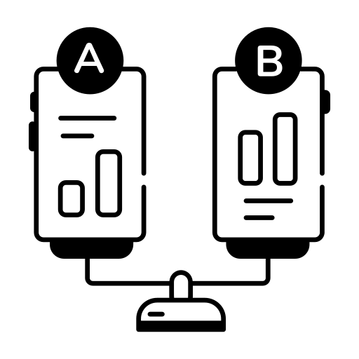
As a next step, segment the referral ecosystem to reveal regional structures and connectivity roles
OBJECTIVE: Detect natural referral communities and characterize influence and routing differences across them
Ecosystem Segmentation
Hub & Influence Characterization
Regional Comparative Profiling
Apply community detection algorithms to uncover cohesive referral ecosystems
Identify hub institutions and group practices central to patient routing within HUBs
Evaluate structural differences across territories by comparing metric distributions and profiling how connectivity flows across ecosystems
Validate cluster cohesion and boundary strength using internal vs external routing patterns
Assess specialty distribution and leadership concentration to further characterize identified HUBs
Detect underserved or fragmented ecosystems while uncovering equity of hub presence and network density
Map clusters to territories and HCO affiliations to roll-up the insights
Evaluate inbound/outbound referral dominance to outline where influence concentrates in these clusters
Key Business Questions Addressed
How are territorial referral ecosystems structured and how do they differ across regions?
Which HCP/HCOs function as hubs capable of influencing care access?
How are referral leadership and specialty coverage distributed across territories?

Slide 31



Further understand how influence propagates across referral relationships to shape adoption behavior
OBJECTIVE: Evaluate whether connected providers behave independently or exhibit influence-driven adoption patterns
Influence Assessment
Behavioral Alignment
Propagation Quantification
Compute network connectivity and path-dependence metrics to identify structurally influential HCPs
Compare adoption timing across connected HCP neighborhoods to detect leader–follower dynamics within referral pathways
Evaluate peer exposure across referral connections to estimate strength and reach of influence spread
Layer in incremental primary data (e.g., social media, publications, conferences etc.) to further map social influence roles
Evaluate behavioral alignment among connected providers to assess diffusion consistency across clusters
Quantify propagation potential along routing pathways
Map influence roles across specialties and territories to isolate providers embedded within high-impact referral pathways
Identify influence beyond treatment adoption through social connections to surface non-obvious drivers
Identify ecosystems most conducive to influence-driven adoption
Key Business Questions Addressed
How does adoption spread through the referral network and to what extent is it influenced by the connected HCPs?
Which providers and ecosystems exert the strongest influence and act as noticeable leaders?
How can the influence effects be quantified using network connectivity measures?

Slide 32
Pinpoint where patient flow breaks down to uncover referral inefficiencies and leakage hotspots
OBJECTIVE: Detect loss points in referral journeys and characterize structural drivers of missed or delayed care transitions
Journey Deviation Detection
Leakage Hotspot Identification
Root Cause Profiling
Reconstruct longitudinal patient pathways across providers using claims-derived care transitions
Quantify transition drop-offs between key stages of diagnosis and treatment routing
Profile structural attributes associated with leakage (network isolation, specialty scarcity, routing fragmentation)
Establish expected routing patterns by specialty progression and temporal sequencing
Identify under-referring providers and weak outbound pathways limiting downstream access
Evaluate ecosystem differences to surface systemic vs localized barriers
Compare observed journeys against expected pathways to detect deviations and extended discontinuities
Detect geographic gaps where patients exit ecosystems or fail to reach appropriate hubs for a long duration
Link leakage patterns to provider and regional traits to inform intervention prioritization
Key Business Questions Addressed
Where and why are patients lost or delayed along referral journeys?
Which providers, pathways, or regions contribute most to leakage risk?
What structural characteristics are associated with under-referral or access gaps?

Slide 33
These metrics together help identify who receives patients, redirects them, ensures correct routing, and drives overall influence in the referral network
Metric | Definition | Business Implication
Weighted Indegree | The volume of patients being referred into an HCP, exponentially adjusted for the recency of such interaction | A high indegree HCP is a destination others consistently route patients toward
Weighted Outdegree | The volume of patients an HCP refers out, exponentially adjusted for the recency of such interaction | High outdegree HCPs are coordinators who are actively moving patients forward in the care journey
Betweenness Subset Centrality | How often an HCP sits on the path between two other HCPs who wouldn't otherwise be connected | Highest-leverage engagement targets acting as the bridges of the network
PageRank | Not just how many referrals an HCP receives, but how important the HCPs sending those referrals are | It measures influence by the quality of who endorses you beyond how many patients are being referred
Leiden Community Detection | Identifies naturally occurring, well-separated clusters (communities) of HCPs who refer amongst themselves more than they refer outside their group | Each community indicates where patient care is self-contained within a tight-knit group versus where it flows across broader networks
Absorbing Markov Chains | Maps the referral journey as a series of probabilistic steps, identifying which HCPs patients eventually landed at | Identifies which HCPs are more likely to provide a referrals leading to misdiagnosis or mismanagement

Slide 34
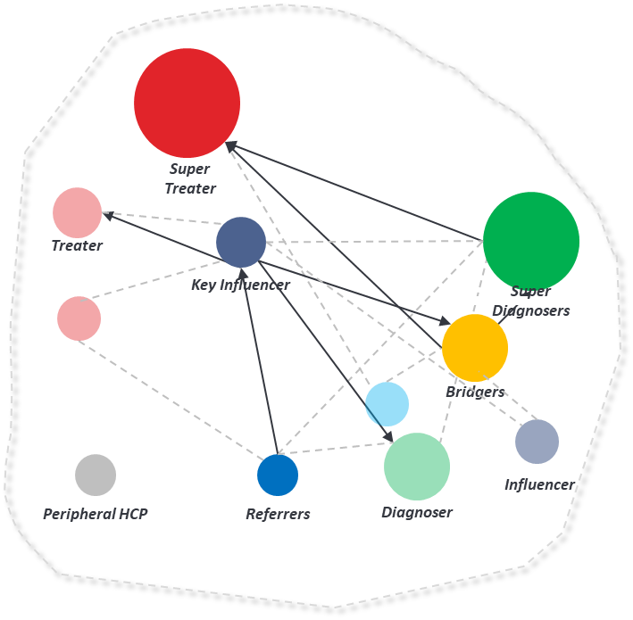
Key Personas: A small, high-impact cohort of 5% HCPs accounts for a disproportionate share of 53% of top-decile targets in the NT network
KEY PERSONAS
AUXILIARY PERSONAS
Super Treaters: 0.47% (n=315)
Managing NT1 relevant treatment for a high-volume of patients
Low Value Treaters: 0.42% (n=286)
Super Diagnosers: 1.06% (n=717)
Consistently seeing and diagnosing a high-volume of patients with NT1
Low Value Diagnosers: 0.64% (n=430)
Bridgers: 0.41% (n=280)
Key HCP redirecting the patient to the targeted HCPs for NT1 diagnosis or referrals
Key Influencers: 1.88% (n=1,271)
Highly connected HCPs managing and redirecting a high-volume of patients
Low Value Influencers: 0.93% (n=628)
Super Referrers: 0.81% (n=549)
HCPs actively redirecting patients to other HCPs in their referral network
Low Value Referrers: 66.18% (n=44,753)
Total HCPs: 3,132 (5% of the Universe)
% of Identified Targets Covered*: 29%
% of Identified Decile 5-10 Targets Covered^: 53%
Total HCPs: 46,097 (69% of the Universe)
% of Identified Targets Covered*: 46%
% of Identified Decile 5-10 Targets Covered^: 33%
* Amongst target list HCPs who are part of Referral Universe : N=7,562
^ Amongst Decile 5-10 target list HCPs who are part of Referral Universe : N=2,584

Slide 35
Innovators are the most represented group in the identified set of personas followed by Holistic Treaters
Personas | N-Size | Holistic Treaters | Traditionalists | Innovators | Off-Target
Super Treaters | 315 | 22% (68) | 2% (7) | 72% (226) | 4% (14)
Super Diagnosers | 717 | 23% (162) | 3% (19) | 69% (495) | 6% (41)
Bridger | 280 | 26% (72) | 8% (22) | 28% (77) | 39% (109)
Key Influencers | 1271 | 28% (353) | 7% (90) | 35% (447) | 30% (381)
Super Referrers | 549 | 17% (93) | 7% (36) | 8% (45) | 68% (375)
Low value Treaters | 286 | 31% (89) | 12% (35) | 40% (114) | 17% (48)
Low value Diagnosers | 430 | 25% (107) | 8% (33) | 33% (142) | 34% (148)
Low value Influencers | 628 | 27% (169) | 7% (46) | 27% (169) | 39% (244)
Low value Referrers | 44753 | 3% (1352) | 2% (769) | 1% (437) | 94% (42195)

Slide 36
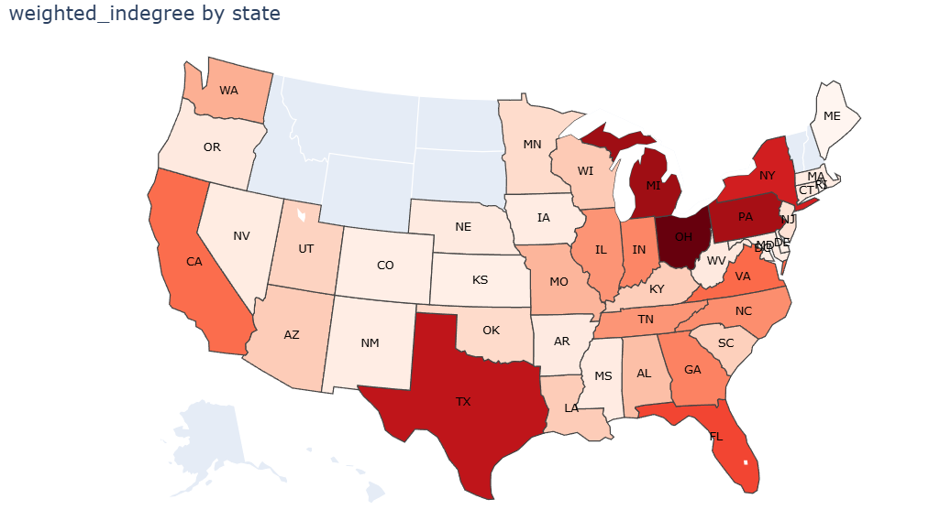
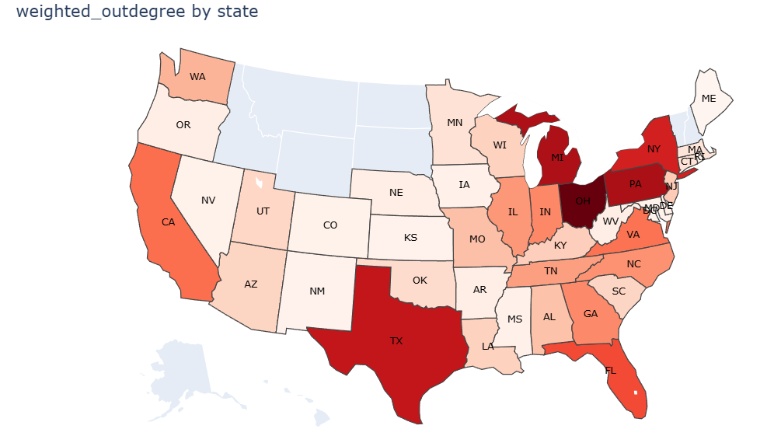
NT referral activity is geographically concentrated in the Southeast and mid-Atlantic, but high volume does not always signal a well-connected network
Key Insights
OH is the single most active referral hub in the country with HCPs referring and rendering activity, followed by MI, PA and NY
The Southeast corridor (VA, TN, GA, NC, SC, FL) shows consistently elevated activity across both metrics indicating regional clusters with more structured referral activities

Slide 37
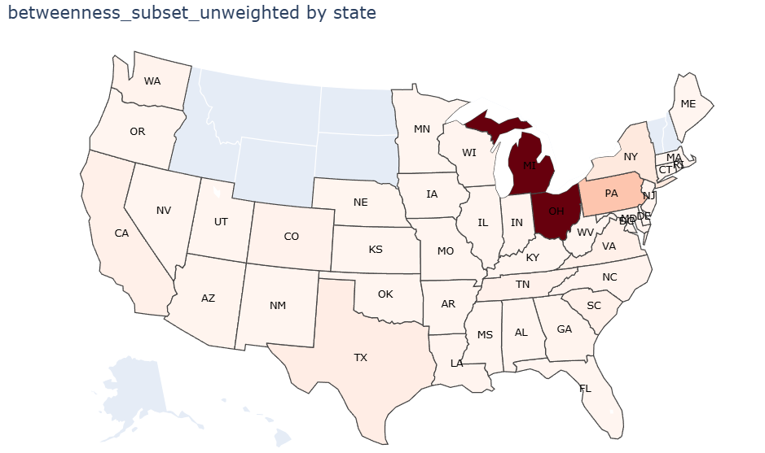
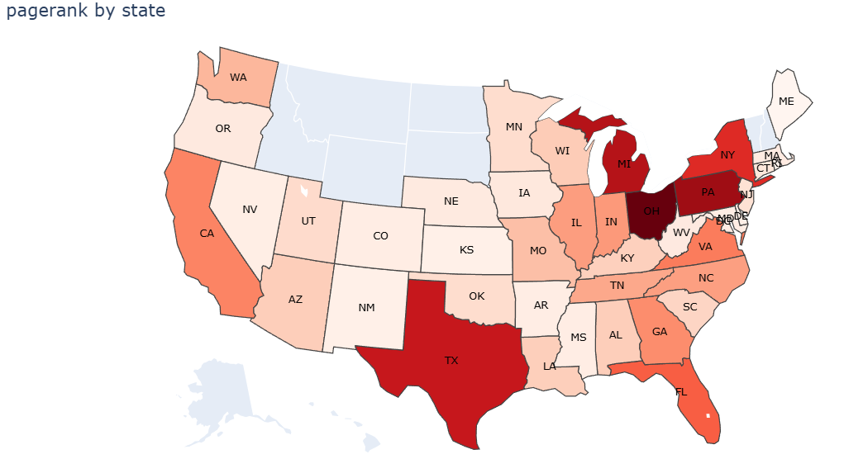
Michigan, Pennsylvania, and Ohio form the structural backbone of the NT referral network, where engagement has the highest systemic leverage beyond raw volume
Key Insights
FL and CA shows strong indegree and outdegree consistent with specialist concentration, but the network influence metrics indicate a lack of establish referral pattern
MI, PA and OH show strongest signal of a mature, trusted referral network with most critical bridges and high-quality inflow making them most structurally complete market in the country

Slide 38
NT referral communities are defined by relationships, not institutions as HCPs consistently refer within their behavioral network regardless of where they practice
Identifying the underlying clusters
6,174
Total HCP Clusters
Communities with 3 or more HCPs exchanging the referrals primarily amongst themselves
548
Self-sustained HCP HUBs
Communities with 1-2 HCPs managing 2+ patients and diagnosing or treating more than 67% of them
4,871
Standalone HCPs cohorts
1-2 connected HCPs with no prominent referral or treatment activity

Slide 39
NT referral communities are defined by relationships, not institutions as HCPs consistently refer within their behavioral network regardless of where they practice
Referral activity concentration
Identifying the underlying clusters
6,174
Total HCP Clusters
Communities with 3 or more HCPs exchanging the referrals primarily amongst themselves
548
Self-sustained HCP HUBs
Communities with 1-2 HCPs managing 2+ patients and diagnosing or treating more than 67% of them
4,871
Standalone HCPs cohorts
1-2 connected HCPs with no prominent referral or treatment activity
Key Insights
Patients are not being systematically funneled toward high-expertise centers. Instead, wherever a patient lands, a micro-community of HCPs manages them in isolation
99% of identified HCP clusters contain the majority of their referral activity within the community. Confirming that referral behavior in NT market is governed by established HCP relationships, not institutional proximity or affiliation
With ~5 patients per cluster, individual HCPs never accumulate sufficient NT patient volume to become confident specialists, which could potentially perpetuate misdiagnosis, diagnostic delay, and suboptimal treatment decisions at the community level
Only 26% of the referrals are within the same corporate account, indicating cross-institutional communities participating in referrals
Identifying these communities requires uncovering HCP clusters

Slide 40
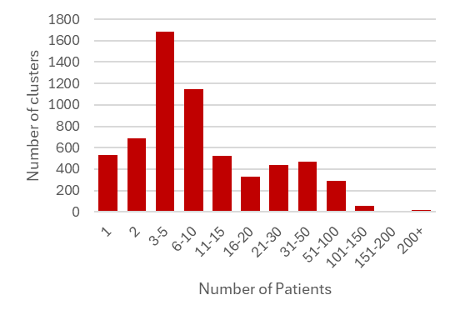
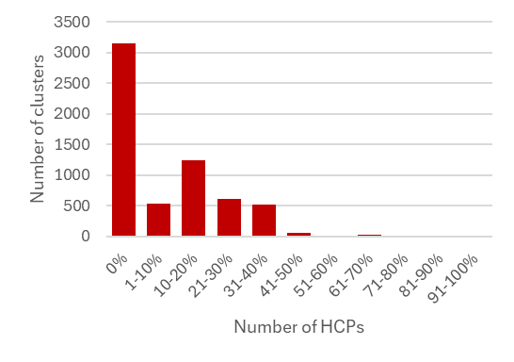
The majority of NT referral clusters are small, PCP-led communities with near-zero overlap with current target lists, indicating that most NT patient management is occurring below the commercial radar
Cluster Profiling
NT Patients Managed Across Clusters
HCP Concentration Across Clusters
Top 10 States Accounting for 50% of Cluster Concentrations
State Code | % of Clusters Covered
TX | 7%
CA | 7%
FL | 6%
OH | 6%
NY | 5%
MI | 4%
PA | 4%
NC | 3%
IN | 3%
TN | 3%
Target List Constitution Within Clusters
Decile 6-10 Constitution Within Clusters
Primary Specialty Across Clusters
Speciality | % of Clusters Covered
Sleep Specialists | 3%
Neurology | 4%
Psychiatrist/ Psychologist | 18%
Pulmonologist | 4%
PCP/NP/PA | 58%
Others | 13%

Slide 41
Misdiagnosis affects at least 70% of NT patients, with Anxiety and Fatigue driving early diagnostic misdirection and Sleep-related conditions serving as the most proximate gateway to NT identification
 |  | Where in the patient Journey are patients getting dropped |  |  |  | Traits associated with these Leakage points
Misdiagnosis | Number of Patients | % of Patients that get this misdiagnosis | Avg Delay per Patient (# days) | Median Delay per Patient (# days) | Total Delay for all Patients (# days) | Avg Days to NT Dx (from the Last Dx) | Median Days to NT Dx (from the Last Dx)
Anxiety Disorder | 23,680 | 70% | 359 | 226 | 8,492,939 | 335.47 | 122
Mood Disorder | 24,554 | 72% | 361 | 225 | 8,857,740 | 318.95 | 117
ADHD | 8,216 | 24% | 346 | 213 | 2,846,010 | 331.42 | 98
Chronic Pulmonary Disease | 4,782 | 14% | 328 | 153 | 1,566,489 | 361.15 | 130
Epilepsy | 2,907 | 9% | 234 | 97 | 679,325 | 409.82 | 179
Sleep Apnea | 18,953 | 56% | 344 | 208 | 6,512,208 | 248.29 | 43
Sleep Disorder | 21,697 | 64% | 171 | 97 | 3,705,528 | 324.17 | 89
IH | 2,155 | 6% | 141 | 62 | 304,070 | 317.81 | 94
Fatigue | 21,613 | 64% | 129 | 72 | 2,784,873 | 477.33 | 286
Key Insights
The typical patient journey starts with non-specific psychological and fatigue-related conditions (Fatigue, Anxiety and Mood Disorder), transitions through neurological misclassifications (Epilepsy and ADHD), and eventually converges toward sleep-related diagnoses (Sleep Disorder, Sleep Apnea) just before narcolepsy is identified.
The proximity of a misdiagnosis to NT identification varies significantly by condition: Sleep Apnea and Sleep Disorder consistently appear as the final misdiagnosis before NT is confirmed, making the HCPs managing these patients, even beyond sleep specialists, the most actionable intervention point
Early journey HCPs: Those managing Fatigue, Anxiety, Mood Disorder pose an opportunity for awareness and earlier NT suspicion
Late journey HCPs: Those managing Sleep Apnea and ADHD showcase opportunity on building confirmation confidence for faster NT referrals & Diagnosis

Slide 42
Markov Chain Analysis Reveals Systemic Pre-Diagnosis Referral Leakage through Specialty and Persona
* Treaters and Diagnosers are part of the targets, thus they have a 0-misreferring score
Misreferring Score | NP/PA | Neurology | Other Non-Specialists | Other Specialists | PCP | Psychiatrist | Psychologist | Pulmonologist | Sleep Specialists
0 | 47.70% | 51.00% | 46.30% | 48.70% | 52.30% | 42.90% | 46.50% | 41.60% | 55.70%
0.0–0.2 | 2.70% | 3.10% | 2.50% | 2.80% | 2.70% | 3.30% | 3.50% | 2.90% | 3.10%
0.2–0.4 | 6.60% | 6.90% | 7.20% | 6.70% | 6.50% | 8.10% | 7.20% | 8.60% | 7.80%
0.4–0.6 | 12.60% | 10.30% | 14.60% | 10.50% | 11.90% | 13.60% | 11.60% | 13.50% | 8.50%
0.6–0.8 | 8.30% | 6.90% | 8.80% | 6.50% | 7.70% | 8.10% | 6.20% | 8.90% | 5.70%
0.8–1.0 | 4.90% | 3.70% | 4.70% | 2.80% | 3.70% | 3.60% | 3.20% | 4.70% | 3.00%
1 | 17.10% | 18.00% | 15.80% | 22.20% | 15.30% | 20.40% | 21.90% | 19.80% | 16.20%
# of HCPS | 6724 | 2274 | 4786 | 5033 | 23499 | 3950 | 4051 | 2303 | 1407
BRIDGER | DIAGNOSER | INFLUENCER | REFERRER | TREATER | All Other HCPs in Referral Universe
25.00% | 100.00% | 36.20% | 19.20% | 100.00% | 49.10%
15.40% | 0.00% | 4.90% | 10.10% | 0.00% | 2.70%
27.50% | 0.00% | 12.70% | 21.90% | 0.00% | 6.60%
21.80% | 0.00% | 17.00% | 23.10% | 0.00% | 12.00%
9.60% | 0.00% | 12.80% | 16.50% | 0.00% | 7.60%
0.70% | 0.00% | 6.20% | 5.50% | 0.00% | 3.80%
0.00% | 0.00% | 10.20% | 3.60% | 0.00% | 18.10%
280 | 717 | 1271 | 549 | 315 | 65039
Key Insights
~56% of Sleep Specialists reliably reach Treaters/Diagnosers through referrals acting as the most effective entry points into the correct care pathways, whereas Psychologists, Psychiatrists, and Pulmonologists lag with ~40% of HCPs reaching target nodes
15–22% of HCPs across most specialties fail to reroute their patients eventually for diagnosis and referrals. This consistent distribution across specialties suggest a systematic issue in the Narcolepsy Market beyond generalists
The identified Bridgers consistently maintain at least some referral relationship which helps redirect patients to targeted HCPs

Slide 43
Misdiagnosis and referral gaps in key specialties are driving the longest delays” “Psychiatry, PCPs, and NP/PAs emerge as major Sink Nodes in the journey
Specialty | Avg. delay (#days) | Primary Point of Delay (Overall) | Primary Point of Delay (Misdiagnosis) | Referrals Made to Sink Nodes
Sleep Specialists | 59.06 | Chronic Pulmonary Disease | IH | 246
Neurology | 71.70 | ADHD | Epilepsy | 435
Psychiatrist | 149.55 | ADHD | ADHD | 517
Psychologist | 206.79 | IH | Mood Disorder | 559
Pulmonologist | 61.43 | Chronic Pulmonary Disease | Chronic Pulmonary Disease | 646
PCP | 83.06 | ADHD | ADHD | 6452
NP/PA | 90.31 | ADHD | ADHD | 1555
Other Specialists | 55.65 | IH | Sleep Disorder | 880
Other Non-Specialists | 51.28 | Sleep Disorder | Sleep Disorder | 1109
Specialty | # of Sink Nodes
PCP | 638
NP/PA | 417
Other Non-Specialist | 67
Other Specialist | 1218
Pulmonologist | 569
Psychologist | 486
Psychiatrist | 934
Neurology | 479
Sleep Specialist | 321
Referral
Key Insights
Post-diagnosis HCP gap: Of 28,864 HCPs interacting post-diagnosis, only 5,052 actively refer, and 19,141 neither refer nor provide relevant narcolepsy treatment, highlighting major post NT diagnosis care gap
Treatment leakage post-diagnosis: 3,454 patients receive no NT-specific treatment; most (3,333) remain in managed care, and 2,152 receive no further referrals—pointing to ineffective post-diagnosis management
*Sink Nodes ~ HCPS that only act as a rendering node (no outgoing referrals), have No NT Activity and are interacting with patients >=1 are classified as a sink Nodes

Slide 44
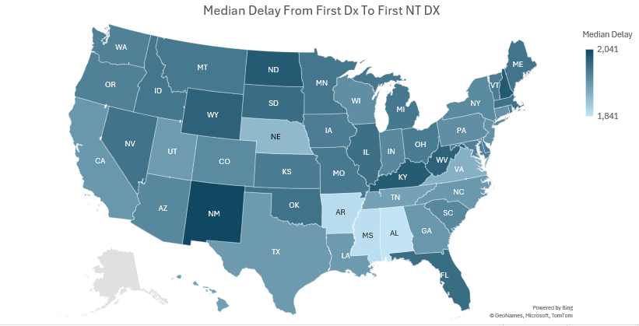
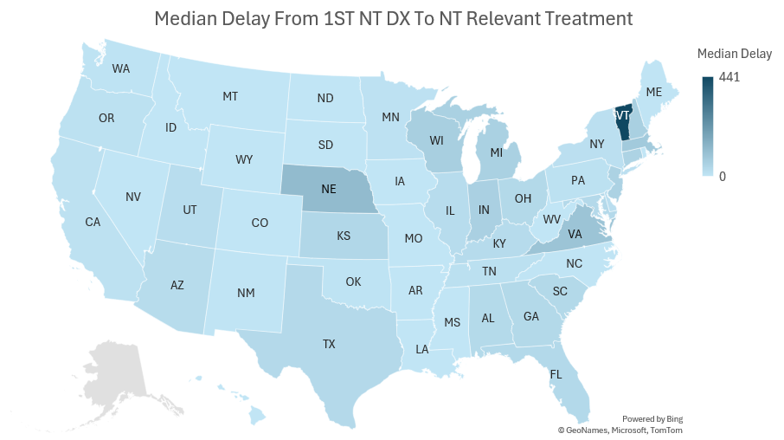
States with the longest diagnostic gaps are not the same where treatment access is slowest, pointing to distinct regional intervention priorities
Key Insights
Pre-diagnosis inefficiency: Only 2,572 patients reach the diagnosing HCP without reaching a sink point in their journey, while 30,086 patients average 4.01 loops, indicating significant referral bottlenecks.
Post-diagnosis treatment drop-off: Out of 17.1K total treated patients, 9.4K received treatment pre-diagnosis, but 3.5K (~37%) discontinue post-diagnosis, indicating a major gap in treatment continuity

